Slide 1
1860: Disunion
The American Battlefield Trust

Slide 2
Expansions and Compromises

Slide 3
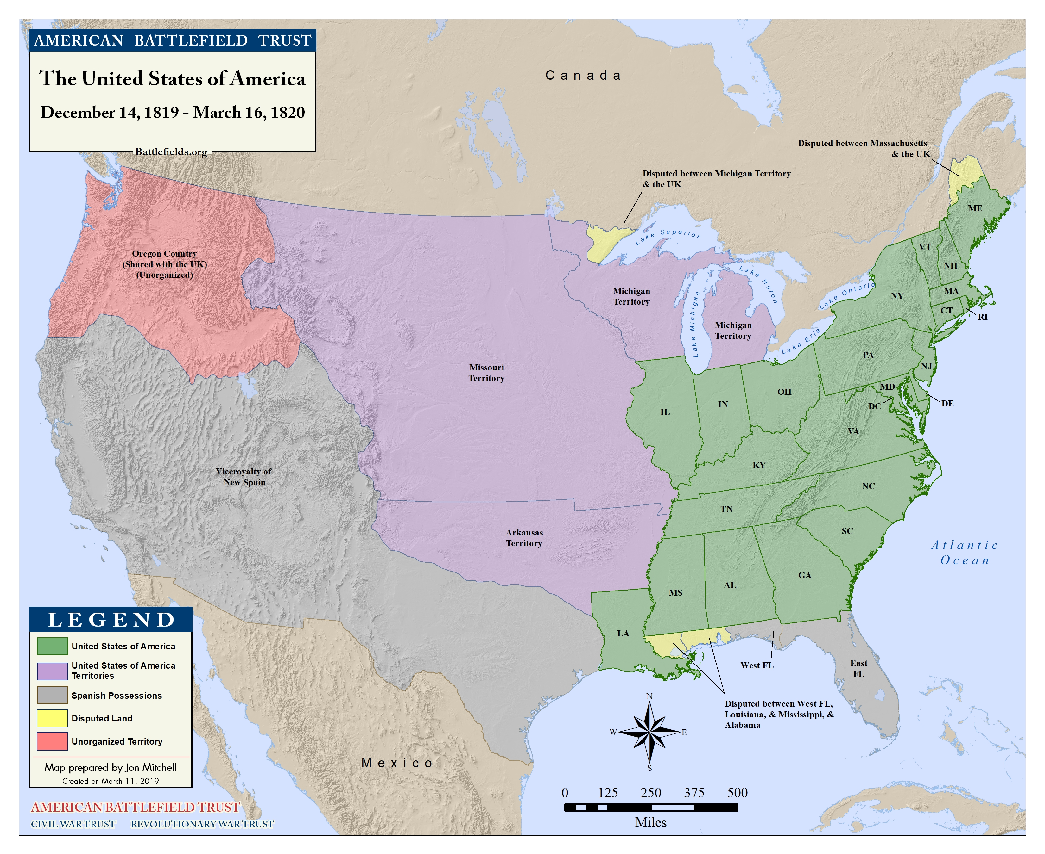
United States in 1820
Notes:
Handout “National Expansion” map and identify free and slave states. Have students follow directions and answer the question.
Explain: The number of free and slave states are currently equal, meaning that representation for all states is equal in congress.
Explain that the Northern free states and Southern slave states had stereotyped views of each other:
Northern free states believed the white Southerners were aristocratic, lazy wealthy planters who succeeded due to slave labor
Southern slave states believed that Northerners were greedy capitalists, commercial and materialistic

Slide 4

How to Resolve?
Notes:
Explain: In 1819 Missouri wants to enter the Union as a slave state. Refer to National Expansion handout and note that if this happens, slave states would have more representation in Congress.
Ask: Should Missouri enter as free or slave?
Use the Compromise Scenario Cards Pick out one or two scenarios. Read the scenarios aloud and discuss as a group what these people would think about Missouri.
Students fill out the Compromise of 1820 part of the Compromise Notes Sheet.

Slide 5
Missouri Compromise
SEC. 8. And be it further enacted. That in all that territory ceded by France to the United States, under the name of Louisiana, which lies north of thirty-six degrees and thirty minutes north latitude, not included within the limits of the state, contemplated by this act, slavery and involuntary servitude, otherwise than in the punishment of crimes, whereof the parties shall have been duly convicted, shall be, and is hereby, forever prohibited: Provided always, That any person escaping into the same, from whom labour or service is lawfully claimed, in any state or territory of the United States, such fugitive may be lawfully reclaimed and conveyed to the person claiming his or her labour or service as aforesaid.
Notes:
Discussion:
According to the document, what is prohibited in the territory north of thirty-six degrees and thirty minutes north latitude?
According to the document, what will happen to a person who escapes to the territory described above?
Why do you think this document from 1820 is relevant when discussing the Civil War?
Note also escaped slaves may be reclaimed.

Slide 6
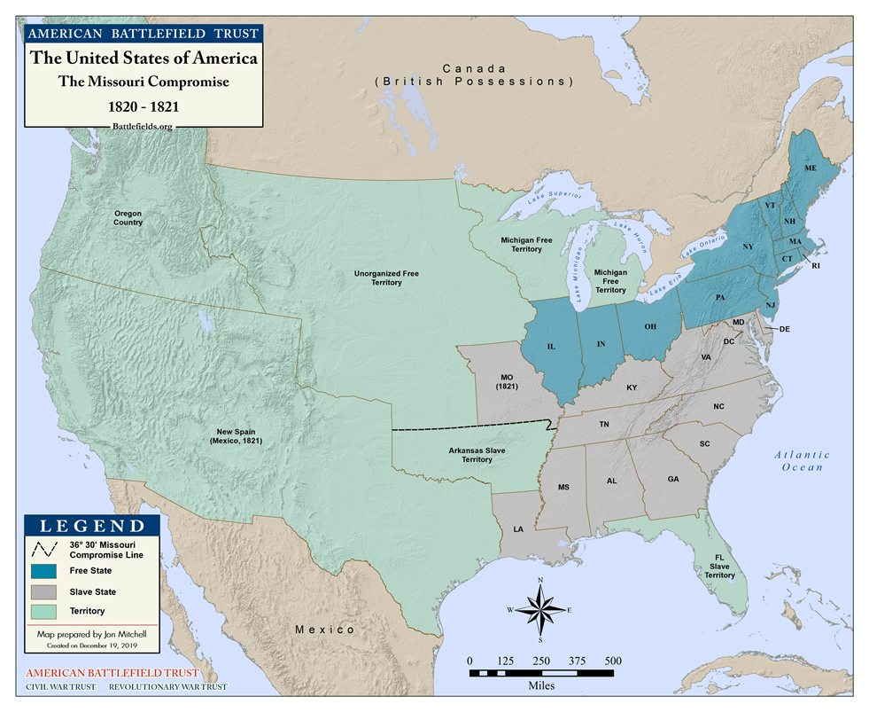
Slave and Free Areas after the Missouri Compromise, 1820

Slide 7
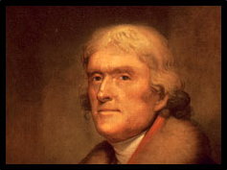
Thomas Jefferson’s Opinion
Read Jefferson’s Letter to John Holmes and complete the Document Analysis Form.

Slide 8
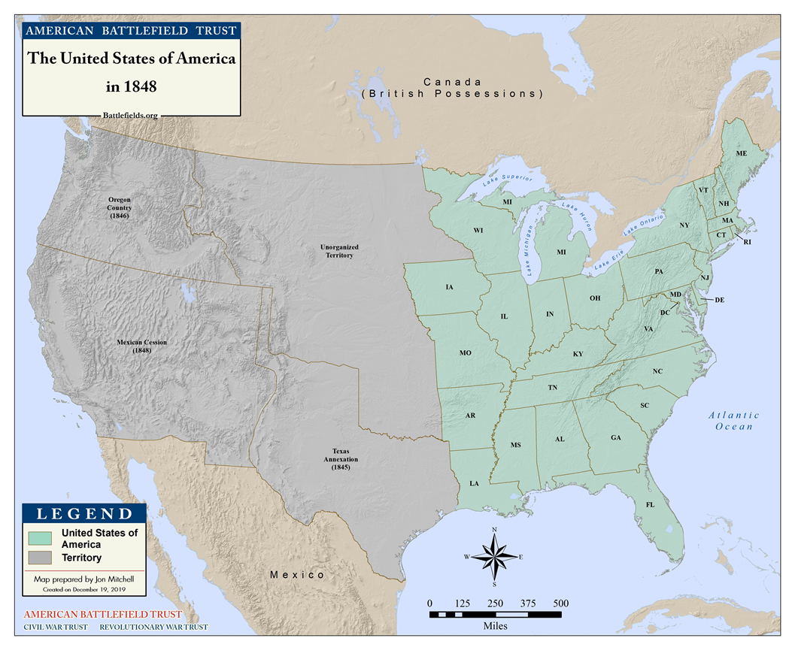
The United States in 1848

Slide 9
How to Resolve?

Slide 10
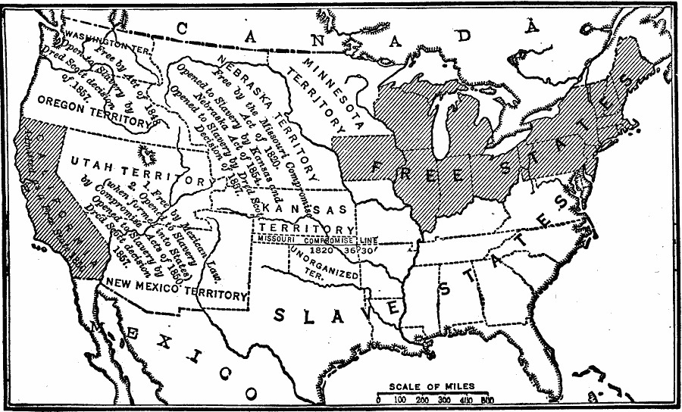
Compromise of 1850
Notes:
Discuss:
According to the Missouri Compromise of 1820, what can the students expect to occur with the territories above and below 36⁰30’?
Map Credit:
Robert Hall, Harriet Smither, and Clarence Ousley, A History of the United States (Dallas, TX: The Southern Publishing Company, 1920) 308. Courtesy the private collection of Roy Winkelman. Retrieved February 11, 2011, from http://etc.usf.edu/maps/pages/5200/5289/5289.htm

Slide 11
Compromise of 1850
It being desirable, for the peace, concord, and harmony of the Union of these States, to settle and adjust amicably all existing questions of controversy between them arising out of the institution of slavery upon a fair, equitable and just basis: therefore,
  1. Resolved, That California, with suitable boundaries, ought, upon her application to be admitted as one of the States of this Union, without the imposition by Congress of any restriction in respect to the exclusion or introduction of slavery within those boundaries.
  2. Resolved, That as slavery does not exist by law, and is not likely to be introduced into any of the territory acquired by the United States from the republic of Mexico…
  8. Resolved, That Congress has no power to promote or obstruct the trade in slaves between the slaveholding States; but that the admission or exclusion of slaves brought from one into another of them depends exclusively upon their own particular laws.
Notes:
Discuss:
According to the document, which institution is causing conflict between the states?
According to the document, did California enter the Union as a free or slave state? (California requested to enter as a free state; therefore, it did without the ‘imposition of Congress.’
According to the document, what does Congress not have the power to do?
How do you think the country reacted?

Slide 12
Excerpt, The Fugitive Slave Act
Section 7
And be it further enacted, That any person who shall knowingly and willingly obstruct, hinder, or prevent such claimant, his agent or attorney, or any person or persons lawfully assisting him, her, or them, from arresting such a fugitive from service or labor,…or shall harbor or conceal such fugitive, so as to prevent the discovery and arrest of such person, after notice or knowledge of the fact that such person was a fugitive from service or labor as aforesaid, shall, for either of said offences, be subject to a fine not exceeding one thousand dollars, and imprisonment not exceeding six months, by indictment and conviction before the District Court of the United States and shall moreover forfeit and pay, by way of civil damages to the party injured by such illegal conduct, the sum of one thousand dollars for each fugitive so lost as aforesaid, to be recovered by action of debt, in any of the District or Territorial Courts…
Section 6
And be it further enacted, That when a person held to service or labor in any State or Territory of the United States, has heretofore or shall hereafter escape into another State or Territory of the United States, the person or persons to whom such service or labor may be due… may pursue and reclaim such fugitive person, either by procuring a warrant or by seizing and arresting such fugitive, where the same can be done without process…
In no trial or hearing under this act shall the testimony of such alleged fugitive be admitted in evidence
Notes:
Explain: In the Compromise of 1850 the Southern slave states agreed to California’s entry as a free state in exchange for a stronger Fugitive Slave Act. The Fugitive Slave Act is part of the Compromise of 1850.
Established by the Judicial Courts of the United States
U.S. Marshalls and slave owners and others can pursue and reclaim escaped slaves in Northern states
Failure to cooperate will result in a $1,000 fine and prison term of up to 6 months.
Ask:
How do you think the citizens of the free states viewed the compromise, especially Section 7?
Why do you think the “Compromise of 1850”, including the Fugitive Slave Act, is called a compromise? What issue do you think they are compromising over?
How do you think people reacted?

Slide 13
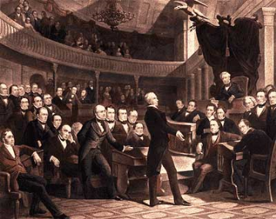
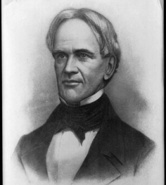
Compromise of 1850 Reactions
“What do you want, you who reside in the free states? Do you want that there shall be no slavery introduced into the territories…? Have you not had your desire in California?...
What more do you want?” Henry Clay
“…the Southern gentlemen have pressed the cause, not only of human slavery but of slavery extension…the North has maintained an unbroken silence. The time has surely come when the voice of freedom should find an utterance.” Horace Mann

Slide 14
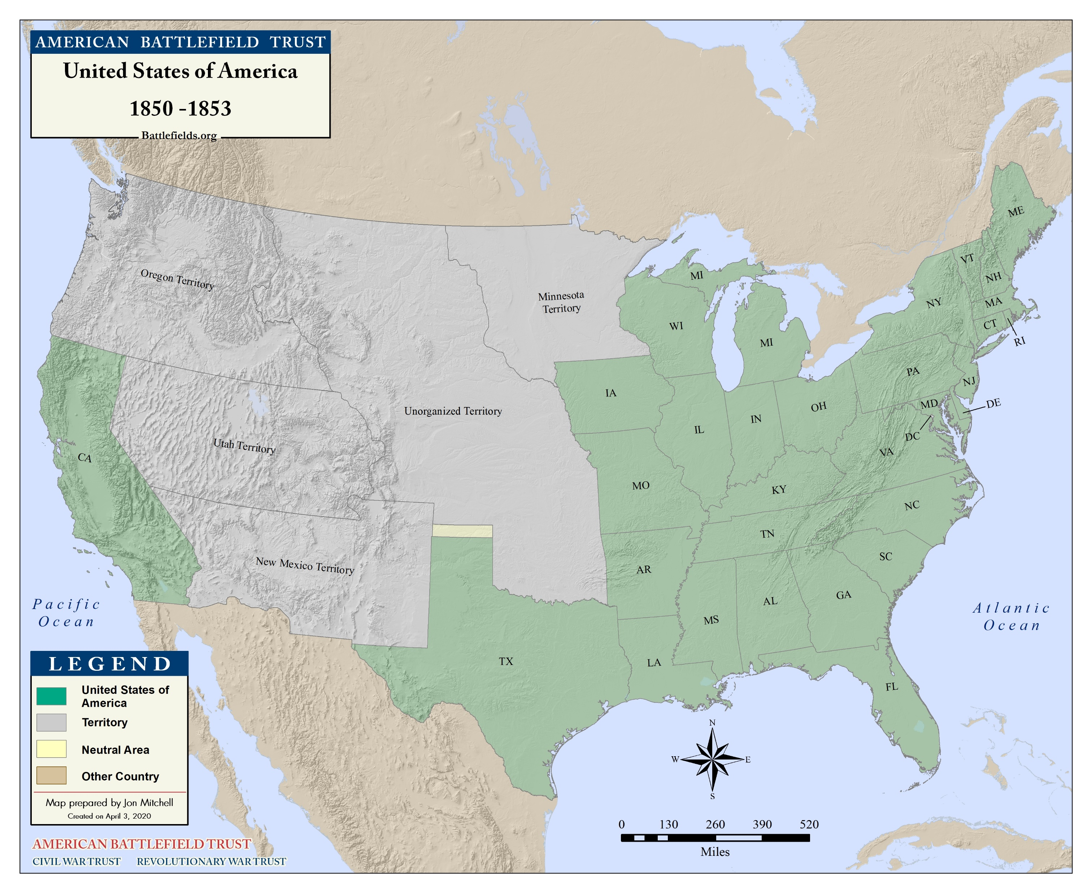
United States in 1850 - 1853
Notes:
Explain: 1854 -Kansas and Nebraska want to join the Union. The US government needs to decide if Kansas and Nebraska should enter as free or slave states.

Slide 15
How to Resolve?
Notes:
Ask: What decision would you make concerning Kansas and Nebraska?
Use the Compromise Scenario Cards Pick out two scenarios. Read the scenarios aloud and discuss as a group what these people might think about Kansas and Nebraska.

Slide 16
Kansas-Nebraska Act, 1854
Territory Nebraska; and when admitted as a State or States, the said Territory or any portion of the same, shall be received into the Union with or without slavery, as their Constitution may prescribe at the time of the admission…
…Territory of Kansas; and when admitted as a State or States, the said Territory, or any portion of the same, shall be received into the Union with or without slavery, as their Constitution may prescribe at the time of their admission…
Opposition: “We arraign this bill as a gross violation of a sacred pledge; as a criminal betrayal of precious rights; as part and parcel
of an atrocious plot to …convert it [the territories] into a dreary region of despotism, inhabited by masters
and slaves….” Salmon P. Chase
Defense: “The legal effect of this bill…is neither to legislate slavery into these territories or out of them, but to leave the people to do as they please….Why should this principle not prevail?” Stephen A. Douglas
Notes:
Discussion:
Both the territories of Kansas and Nebraska were above the line drawn in the Missouri Compromise of 1820. Why do you think it was decided that these new territories would choose their own states’ status of free or slave?
In the four years after this decision, bloodshed and violence dominated these territories with leaders from both slave holding and abolitionist factions. Why do you think these groups were fighting?
How do you think news of this fighting affected Americans throughout the country?

Slide 17
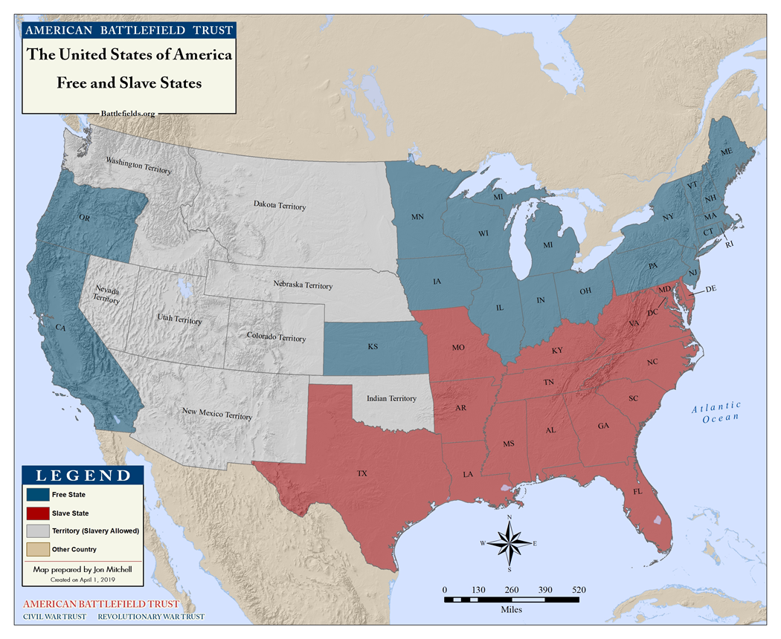
Kansas-Nebraska Act
Notes:
Discussion:
What did the Kansas-Nebraska Act do to the Missouri Compromise? (Repealed the compromise)
Have students fill in the Kansas-Nebraska Act portion of their Comparisons note sheet using one of the scenario cards.

Slide 18
Major Events Prior to the War

Slide 19
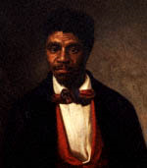
Dred Scott
1857
Scott was a slave who sued for his freedom based upon his extended residence, with his master, in the free states of Illinois and Wisconsin.

Slide 20
Dred Scott
Supreme Court Decision
“They [African Americans] are not included, and were not intended to be included, under the word ‘citizens' in the Constitution, and can therefore claim none of the rights and privileges which that instrument provides for and secures to citizens of the United States.”
“…the act of Congress which prohibited a citizen from holding and owning property [slaves] …north of the line therein mentioned is not warranted by the Constitution and is therefore void…”
Chief Justice Roger Taney, Majority Opinion

Slide 21
Dred Scott
Public Reaction
“It is no novelty to find the Supreme Court following the lead of the Slavery Extension party, to which most of its members belong. Five of the Judges are slaveholders, and two of the other four owe their appointments to their facile ingenuity in making State laws bend to Federal demands on behalf of ‘the Southern institution.’”
- Editorial in the Albany, New York, Evening Journal, 1857
Notes:
Discussion:
According to the document above, whom does this person think the Supreme Court is favoring?
Have students fill in the Dred Scott section on the Compromise Notes sheet using one of the Scenario Cards.

Slide 22
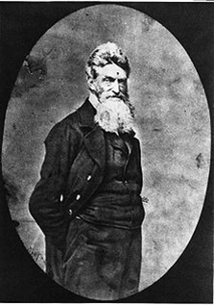
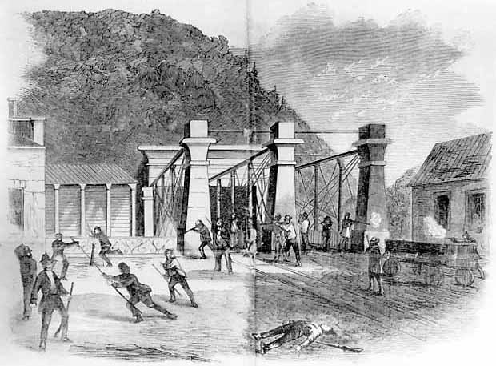
John Brown’s Raid
Harper’s Ferry, VA
October 1859
Notes:
On the evening of October 16, 1859 John Brown, a staunch abolitionist, and a group of his supporters left their farmhouse hide-out en route to Harpers Ferry. Descending upon the town in the early hours of October 17th, Brown and his men captured prominent citizens and seized the federal armory and arsenal. Brown had hopes that the local slave population would join the raid and through the raid’s success weapons would be supplied to slaves and freedom fighters throughout the country.

Slide 23
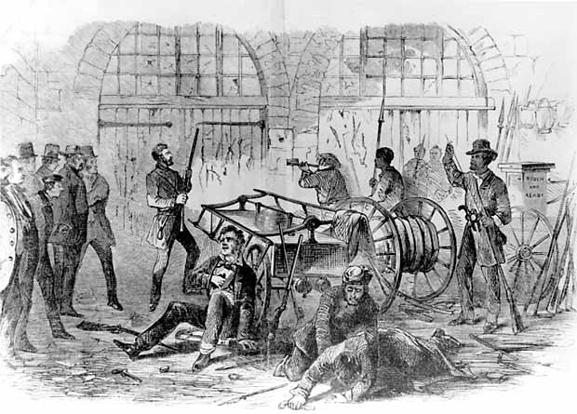
John Brown’s Raid
To Eugenia Burton, Enfield, England
October 18, 1859
This has been one of the saddest days that Harper's Ferry ever experienced. This morning, when the armorers went to the shops to go to work, lo and behold, the shops had been taken possession of by a set of abolitionists and the doors were guarded by Negroes with rifles.
—George Mauzy
Notes:
First held down by the local militia in the late morning of the 17th, Brown took refuge in the arsenal’s engine house. However, this sanctuary from the fire storm did not last long, when in the late afternoon US Marines under Colonel Robert E. Lee arrived and stormed the engine house, killing many of the raiders and capturing Brown.

Slide 24
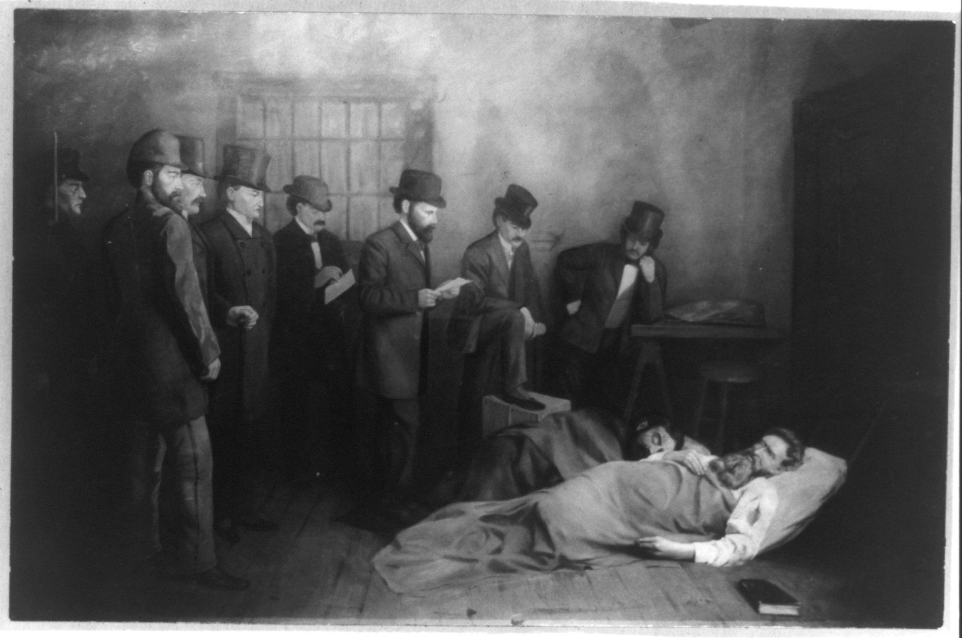
“I, John Brown, am now quite certain that the crimes of this guilty land will never be purged away but with blood.”
Notes:
Brown was quickly placed on trial and charged with treason against the state of Virginia, murder, and slave insurrection. Brown was sentenced to death for his crimes and hanged on December 2, 1859.

Slide 25
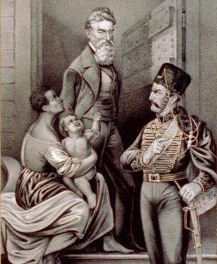
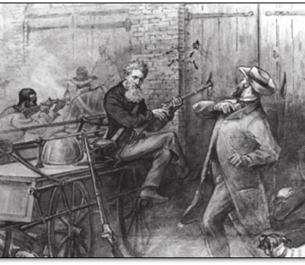
Two Views
What’s Your Opinion?
Martyr
Terrorist
Notes:
Discussion:
Is John Brown a martyr or terrorist? Or both?
Students should fill in the John Brown’s Raid portion of the Comparison Notes sheet using a Scenario Card.

Slide 26
Timeline of Major Events
1820 – Territorial Compromise
1850 – Territorial Compromise, Fugitive Slave Act
1852 – Uncle Tom’s Cabin is Published
1854 – Kansas-Nebraska Act
1856 – The Caning of Charles Sumner
1857 – Dred Scott Supreme Court Case
1859 – John Brown’s Raid

